Slide 1

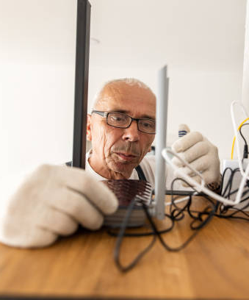
Reducing In-Home Service Cancellations
A $9-10M Transformation
Client: Fortune 500 Telecom
Fiber Internet Division
Lead CX Researcher: Sameena Khan
Notes:
Hi everyone — thanks for having me.
I'm excited to share a project where I led research for a Fortune 500 Telecom’s Fiber Internet Division.
The challenge was big: nearly $8M in potential revenue was walking out the door because customers were canceling during in-home technician visits.
My approach focused on something simple but powerful: building trust — between the customer, the technician, and the company.
By centering on the customer experience, we delivered solutions that not only reduced cancellations but also created lasting business impact.
Let’s walk through how I tackled the problem, what we uncovered, and the transformation that followed."

Slide 2


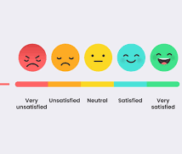

What was the problem?
$8M Crisis
Low CSAT (3.5/5)
Competitors like T-Mobile stealing customers due to easier pricing
40% of customers canceled at in-home installation technician visits
Notes:
Our client was facing a major challenge: nearly 40% of customers canceled during in-home installation visits, resulting in over $8 million in lost revenue and damage to the brand’s reputation.
Our mission was clear: understand why customers were canceling — and fix it.
Even with the technician at the customer’s home, many chose not to complete the installation.
Customer satisfaction scores were low, averaging 3.5 out of 5, signaling frustration and mistrust in the process.
At the same time, competitors like T-Mobile were winning over customers with simpler, more transparent pricing, making it easier for consumers to choose them instead.
It became clear we needed to rebuild trust, simplify the experience, and remove friction points to stop losing customers at the most critical moment.

Slide 3
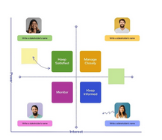
How Did I Approach the problem?
Research Foundations
Secondary Research: Non-buyer Survey Analysis | Mystery Shopping | Internal Data Review
Stakeholder Map: Sales Consultants| Technicians | Heads Of Sales, Product, Marketing, and Installations
Later Stage: Legal & Pricing
Notes:
To tackle the problem, I started by building a strong research foundation.
First, I conducted secondary research — analyzing non-buyer surveys, running mystery shopping exercises, and reviewing internal data to uncover early patterns behind customer cancellations.
Then, I developed a stakeholder map to make sure I understood the full ecosystem — engaging with sales consultants, technicians, and leaders across sales, product, marketing, and installations.
As our work evolved, I also brought in Legal and Pricing teams to ensure that any solutions we designed would align with compliance and pricing transparency requirements.
By combining deep research with early stakeholder engagement, I was able to gather a 360-degree view of the problem and set the stage for alignment and action.

Slide 4
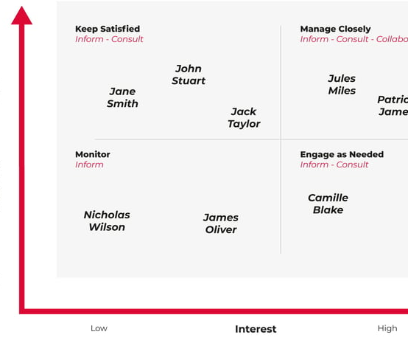
How Did I Align Stakeholders?
Stakeholder kickoff: roles, responsibilities, decision-makers clarified
Refined research objective
Co-created key research questions
Set expectations: deliverables and updates
Notes:
Early and clear alignment was critical to the success of this project.
I made sure that everyone was bought into the research approach from the beginning.
We kicked things off with a stakeholder kickoff meeting — where we clarified roles, responsibilities, and agreed on who the decision-makers would be.
We then refined the initial research objective together to ensure it supported both business goals and user needs.
To build even deeper buy-in, we co-created the key research questions with stakeholders, which also helped surface any early concerns that could have derailed us later.
Finally, I set clear expectations about deliverables, timelines, and how updates would be communicated throughout the project, so there would be no surprises along the way.

Slide 5
What Was the Action Plan?
Lean, Focused Methods Driving Action
Secondary Research & Competitor Analysis
Primary Research
Methods
🗣️ 16 Non-Buyer Interviews → Uncovered pricing distrust.
🎥 12 Technician Shadows → Revealed sales-first culture.
📞 12 Sales Call Audits → Found inconsistent disclosures.
📊 56 Surveys → Quantified “hidden fees” as #1 issue.
Notes:
We prioritized depth over breadth to move quickly and meaningfully.
I lead with Secondary Research — analyzing existing data and reviewing mystery shopper experiences to uncover early signals.
In-depth interviews and technician shadowing helped expose the human reasons behind why customers were canceling.
Sales call audits revealed root causes further upstream in the customer journey.
Finally, targeted surveys confirmed that pricing confusion was the number 1 driver of cancellations.
This lean, focused approach allowed us to align stakeholders and build momentum within weeks, not months — which was critical for a $9–10M problem.

Slide 6
How Did You Gain Stakeholder TRUST?
Conduct Stakeholder Interviews
Share early findings quickly
("low-fidelity" journey map drafts)
Co-create solutions with Technicians + Product teams → buy-in
Secure commitment to pilot A/B tests before full rollout
Host cross-functional workshops (Product, Field Ops, Technicians)

Slide 7
How I MANAGED the Problem
Translated Customer Pain Points Into Clear, Actionable Priorities.
Delivered 3 Actional Insights Based On Customer Research Data Synthesis.
Partnered With Sales, Techs, Product To Redesign Pricing, Training, Technician Incentives, and Communication Flows.
Notes:
Managing the problem meant using research insights as a direct blueprint for action — not just reporting what was wrong.
I didn’t stop at findings. I led design thinking sessions with cross-functional teams, where we used How Might We prompts and crazy 8s brainstorming to generate creative, customer-centered solutions.
Every idea we pursued was directly tied to a measurable business goal — reducing cancellations, improving CSAT, and increasing revenue.
This approach kept everyone focused on outcomes, not just activities, and helped drive momentum from insight to execution.

Slide 8


Research INSIGHTS DELIVERY
1. Customers felt misled when real costs differed from the quoted promotional prices by sales.
2.Technician incentives prioritized upsells over trust.
3. Post-visit communication was confusing or missing.
My bonus depended on upsells. It made it hard to focus on what the customer needed… Technician Larry
Notes:
irst, customers often felt misled because the promotional prices they were quoted during the sales process didn’t match the real costs once the technician arrived. That immediate gap eroded trust before the service even began.
Second, technician incentives were tied to upselling. Instead of focusing purely on getting the customer successfully installed and satisfied, there was pressure to add more services — and customers could feel that, which further damaged trust.
Third, after a technician visit, the follow-up communication was either confusing, unclear, or sometimes completely missing. Customers were left unsure of next steps, making it easier for them to abandon the service altogether.
Together, these issues created a perfect storm for cancellations — and gave us a clear path for what we needed to fix.

Slide 9
VISUALIZATION & Solution Design
Journey Mapping Phase
Solution Design Phase (Co-create ideas, validate with users/stakeholders)
A/B Testing Phase (Prototype, measure results)
I thought the price I was quoted was the final price — I didn’t expect it to go up later.
I felt pressured to buy more services I didn’t really need.”
Notes:
Journey Mapping Phase: I lead the journey mapping phase to visualize the customer experience and identify key pain points where cancellations occurred. This gave me a clear view of the problem areas that needed immediate attention.
Solution Design Phase: Next, I lead the solution design phase by co-creating potential solutions with stakeholders. I facilitated design thinking sessions to validate these solutions with users and key stakeholders to ensure they were aligned with both customer needs and business goals.
A/B Testing Phase: Finally, I lead the A/B testing phase where I prototyped the solutions and measured the results. The data from these tests helped me refine the solutions to maximize impact on cancellations, CSAT, and revenue.

Slide 10
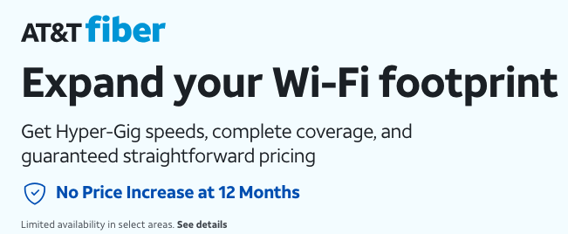

3 Trust-building Solutions
Transparent Pricing Tools
"Trust-first" Technician Training
Post-visit SMS Follow-up Clarity
Anchored Every Solution To Key KPIs (Cancellations, CSAT, Revenue).
Notes:
I led the co-design and design thinking sessions where we developed three key solutions:
Transparent pricing tools to eliminate confusion and providing transparency and no hidden costs.
"Trust-first" technician training to prioritize customer relationships over upsells
Clear post-visit SMS follow-ups for better communication.
Each solution was anchored to key KPIs like cancellations, CSAT, and revenue.

Slide 11
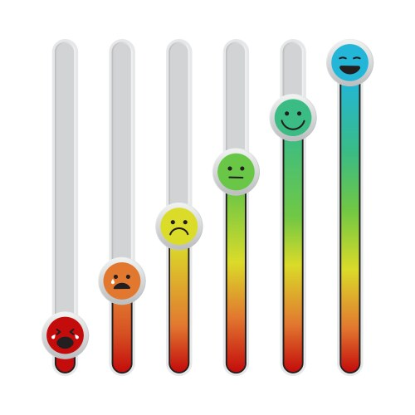
What Was the Outcome?
Cancellation Rate: 40% → 12%
CSAT: 3.5 → 4.5/5
$9-10M in annualized revenue
Technician satisfaction ↑
Notes:
First, we reduced the cancellation rate during technician installation visits — from 40% down to just 12%. This was a major improvement, meaning far fewer customers canceled when a technician came to install their fiber internet service.
Second, technician CSAT scores — how customers rated the installation experience — jumped from 3.5 to 4.5 out of 5. A 29% improvement, largely due to building trust and setting clearer expectations.
Financially, this added up to a $9 to $10 million annualized revenue impact, simply by retaining more customers at the point of install.
And importantly, technician satisfaction improved as well. With incentives tied to customer satisfaction rather than upselling, technicians felt less pressure, more pride in their work, and ultimately delivered better service."

Slide 12
Bonus Outcomes: Long-Term Impact
🔹 “Ask the Expert” program integration
🔹 Technician incentive redesign
🔹 Post-visit SMS campaigns
🔹 UX Designer research training
Notes:
Beyond solving the immediate problem, this project created lasting improvements.
'Ask the Expert' program integration would be like giving customers live access to technicians after the consultation — building more trust and answering last-minute questions that could block conversions.
We also redesigned technician incentives, moving away from upselling quotas toward customer satisfaction and successful installs, reinforcing a trust-first mindset.
Our new post-visit SMS campaigns sent simple, friendly reminders that boosted follow-up conversions by 12%.
Finally, we invested in our team's future: we trained UX designers to conduct their own usability tests and short surveys. This scaled research capabilities and helped foster a truly user-centric culture across multiple product teams."

Slide 13
APPENDIX

Slide 14
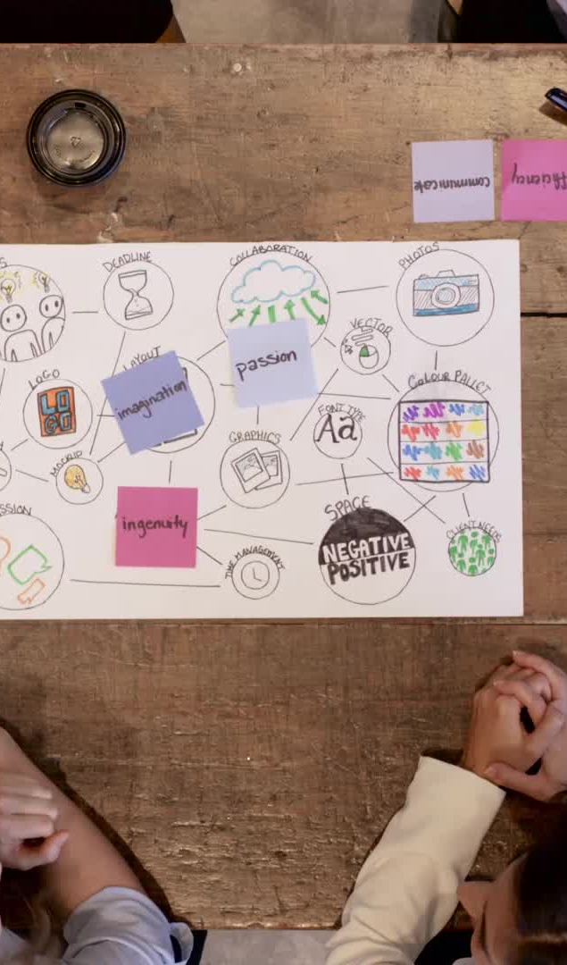
How Did I Manage the Research Synthesis?
Data Collection & Synthesis
Affinity Mapping, Theme Development, Quant Validation
Invited Stakeholders to Collaborate
Applied “3 Cs” Framework:
Connect The Data Points
Contextualize For Business And User Impact
Concrete Next Steps

Slide 15
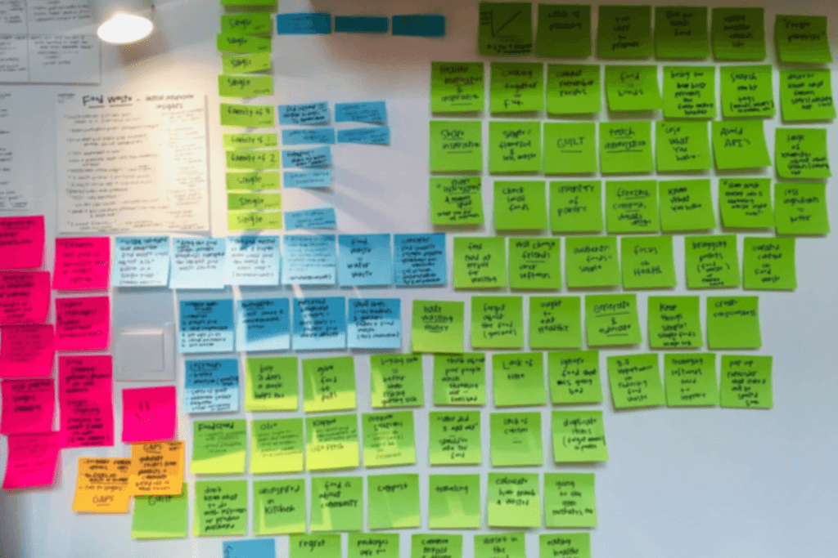
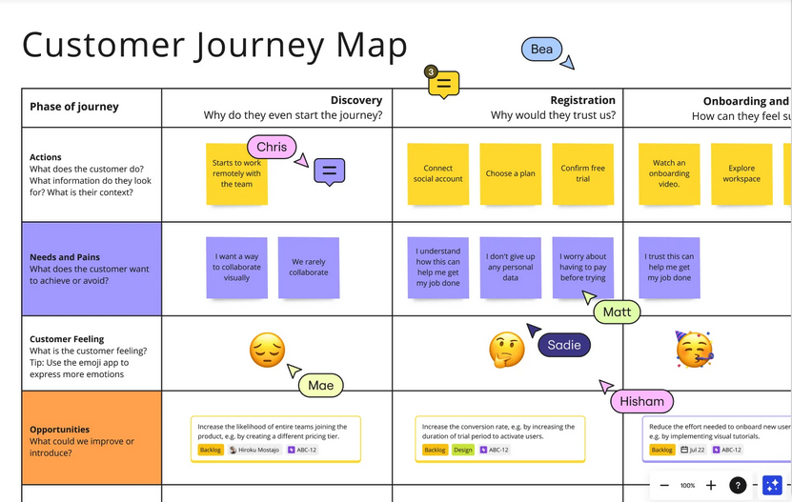
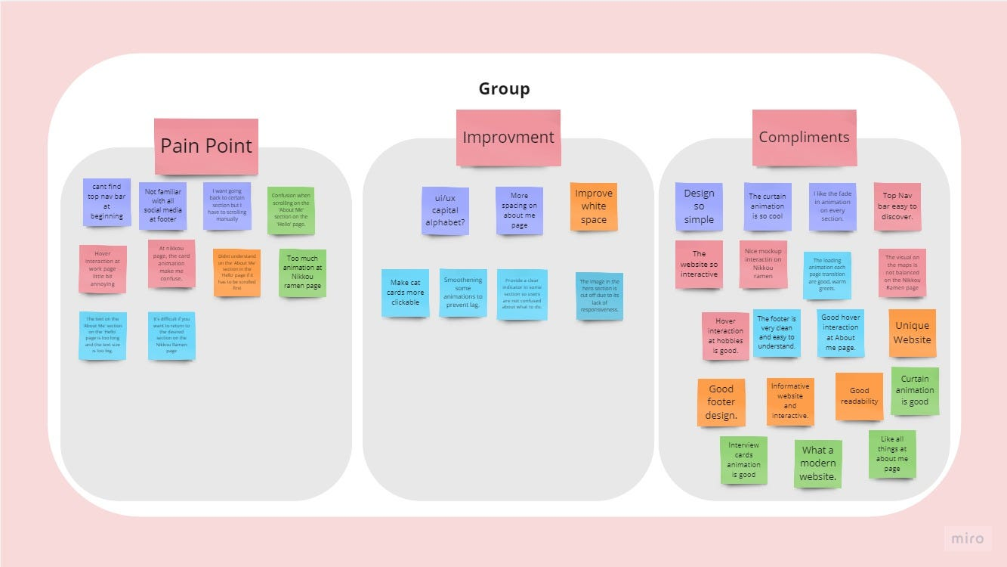
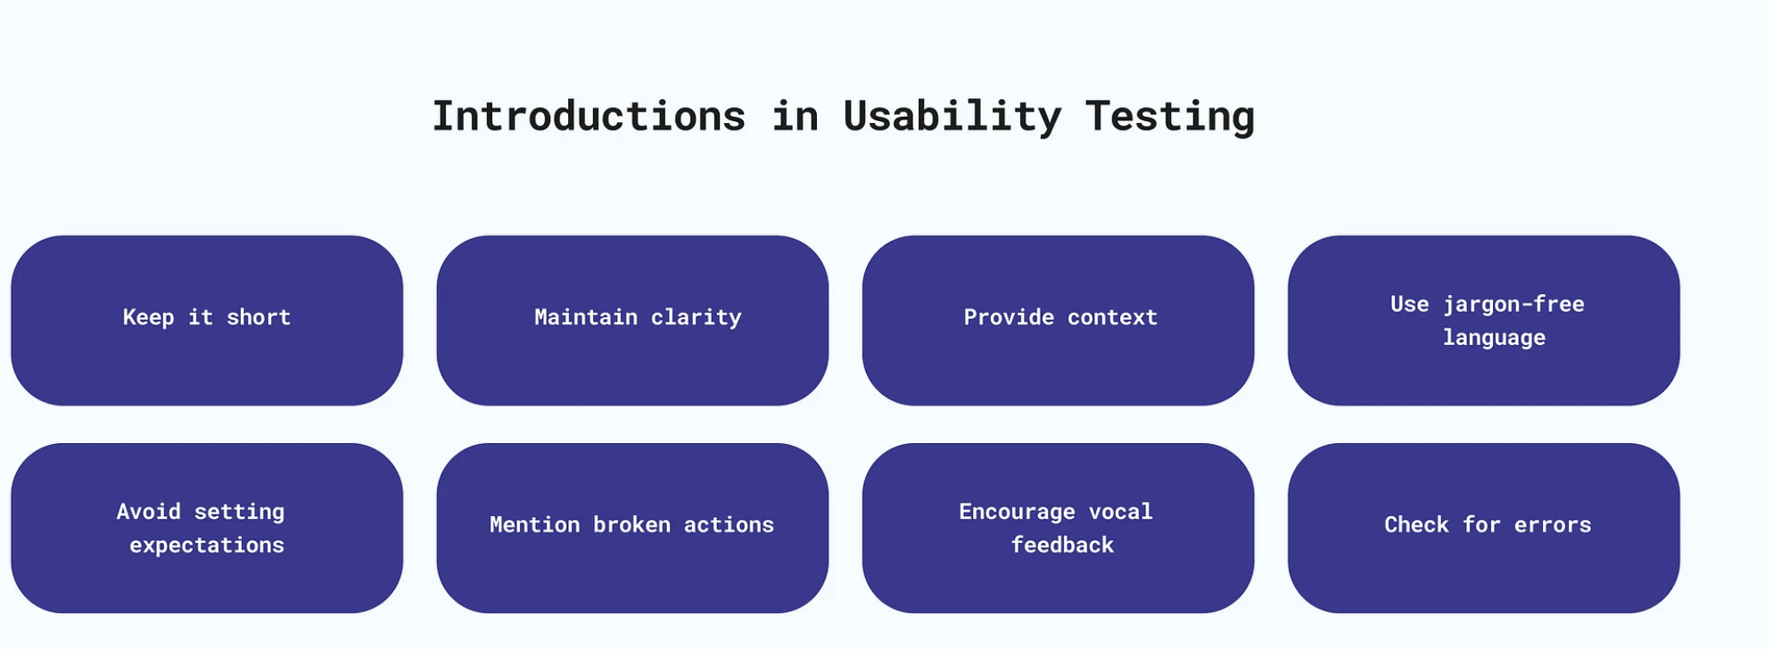

Slide 16

Key Takeaways
Price Transparency is non-negotiable
Technicians are trust brokers, not sellers
Reducing post-visit friction boosts retention

